Slide 1
Main Stitching Methods
First Option:
(Modified) Splicer program from Rosebrock

Slide 2
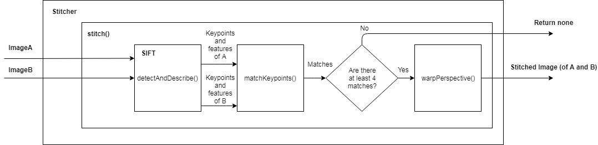

Slide 3
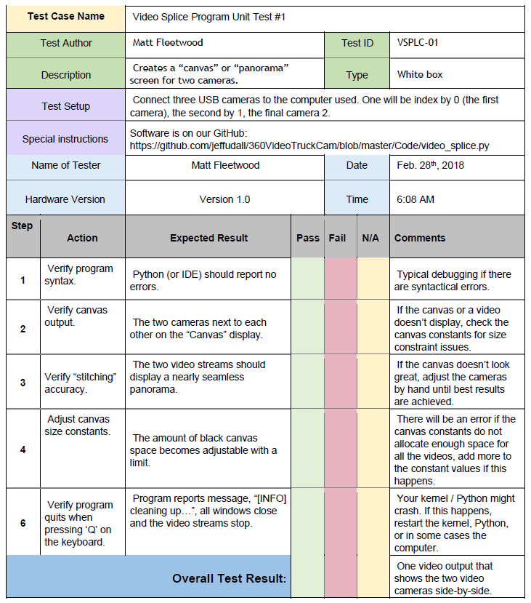

Slide 4
Modified Stitcher from Rosebrock
On our GitHub:
https://github.com/jeffudall/360VideoTruckCam/blob/master/Code/modified_stitcher.py

Slide 5
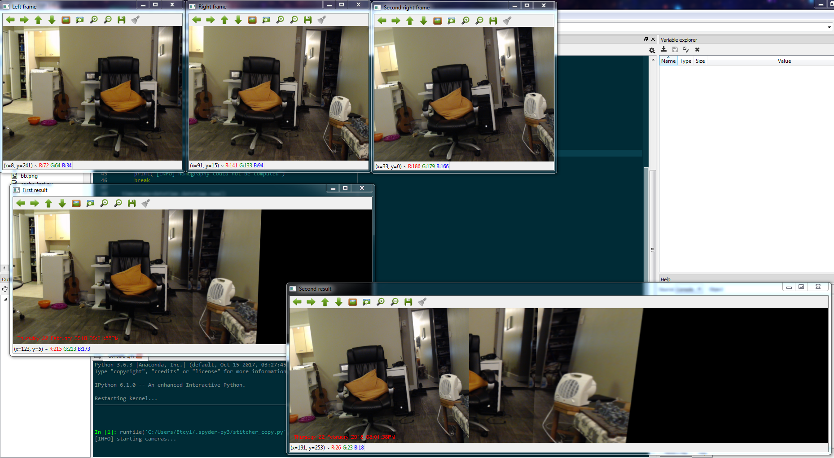

Slide 6
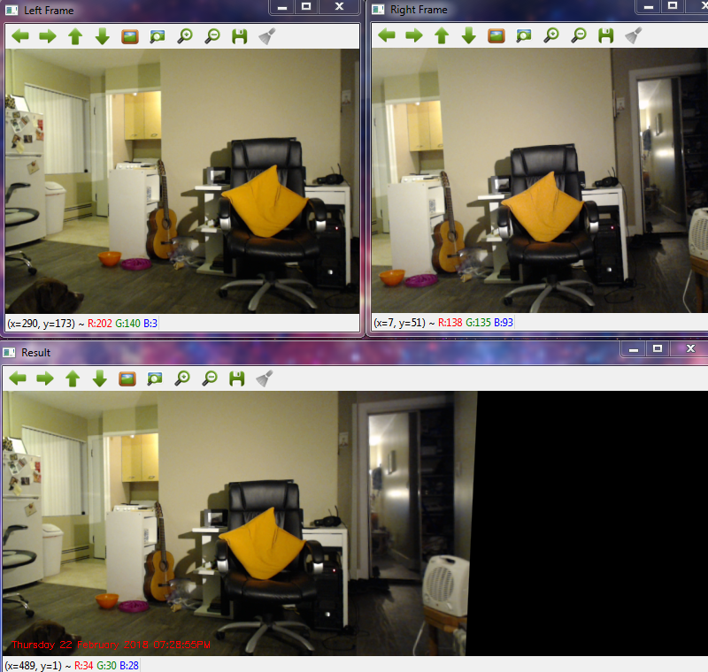

Slide 7
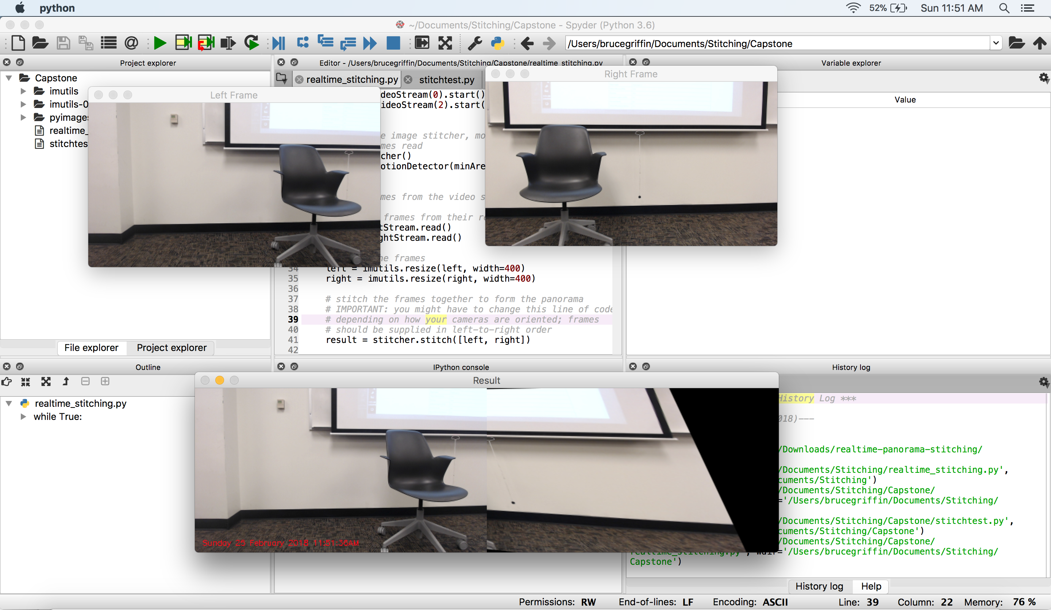

Slide 8
Static Homography Program
On our GitHub:
https://github.com/jeffudall/360VideoTruckCam/blob/master/Code/warp_testing.py

Slide 9
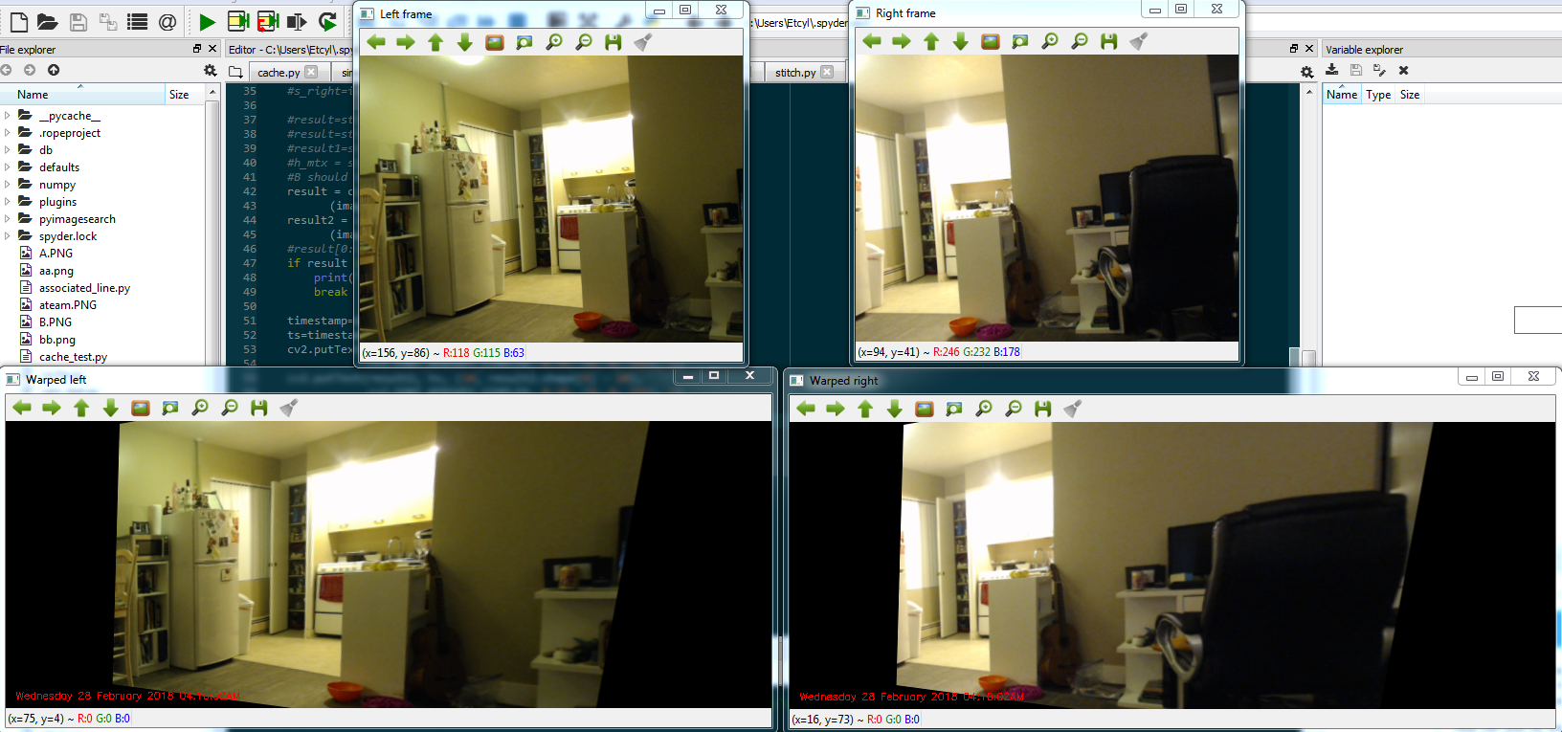

Slide 10
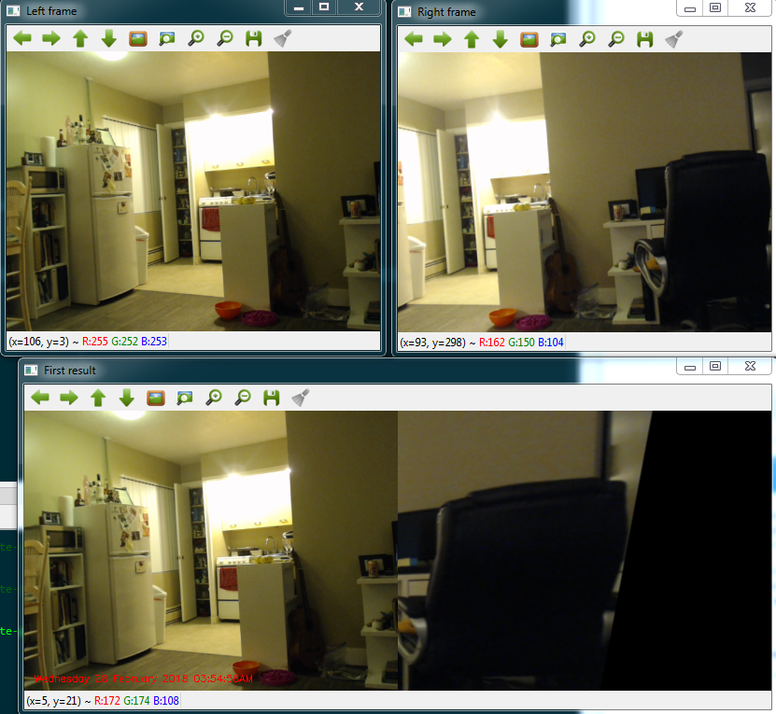

Slide 11
Main Stitching Methods
Second Option:
Video Splice program

Slide 12
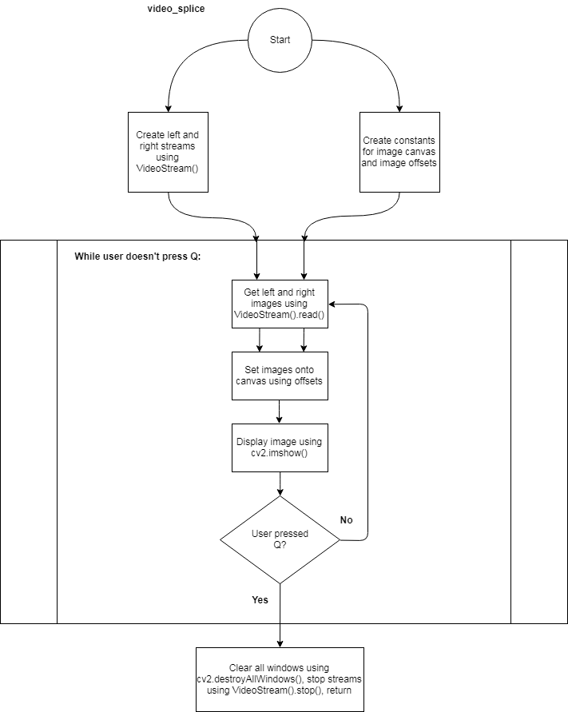

Slide 13
Video Splice Program
On our GitHub:
https://github.com/jeffudall/360VideoTruckCam/blob/master/Code/video_splice.py

Slide 14
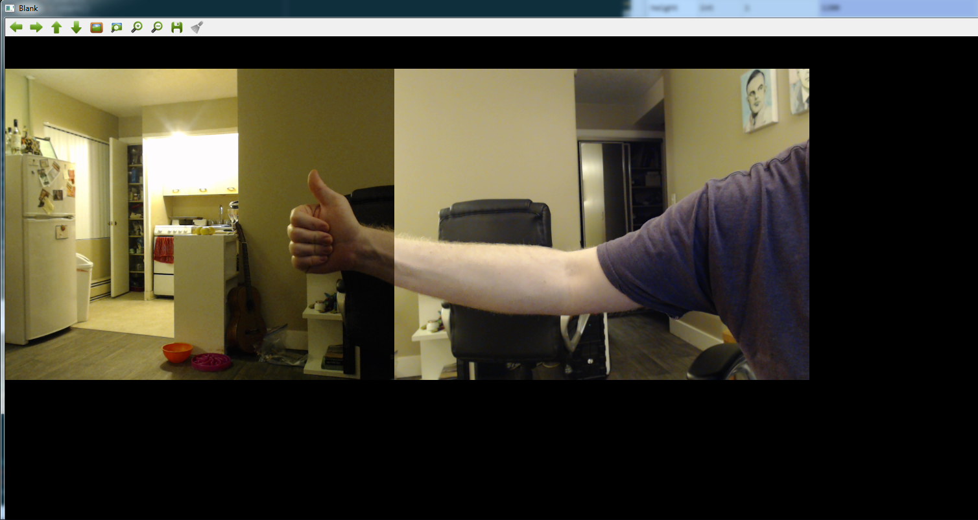
This should say ‘Canvas’

Slide 15
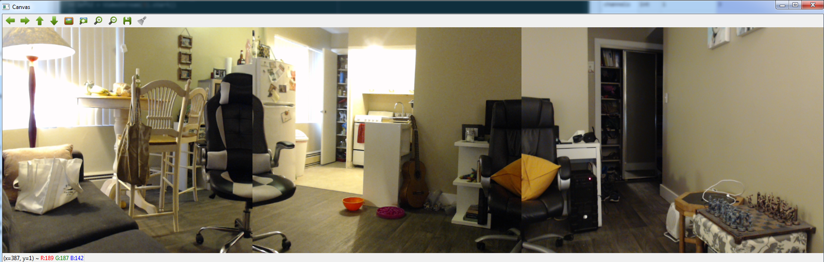

Slide 16
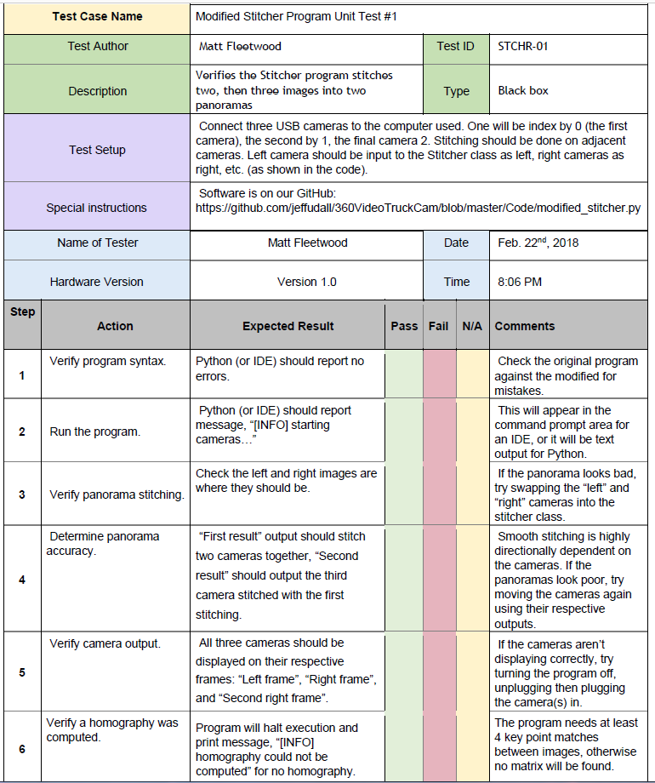
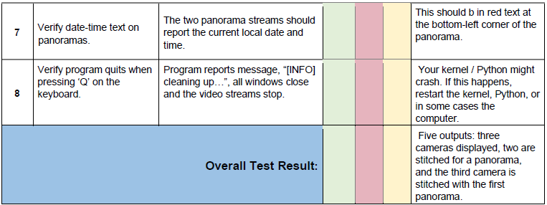

Slide 17
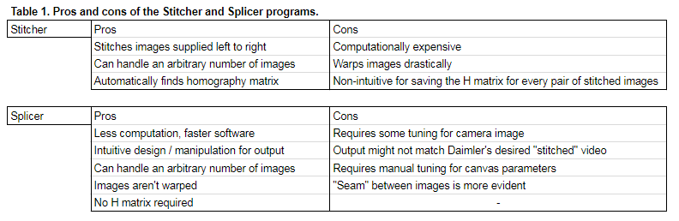

Slide 18
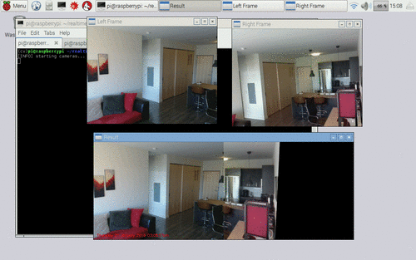
Source: https://www.pyimagesearch.com/2016/01/25/real-time-panorama-and-image-stitching-with-opencv/

Slide 19

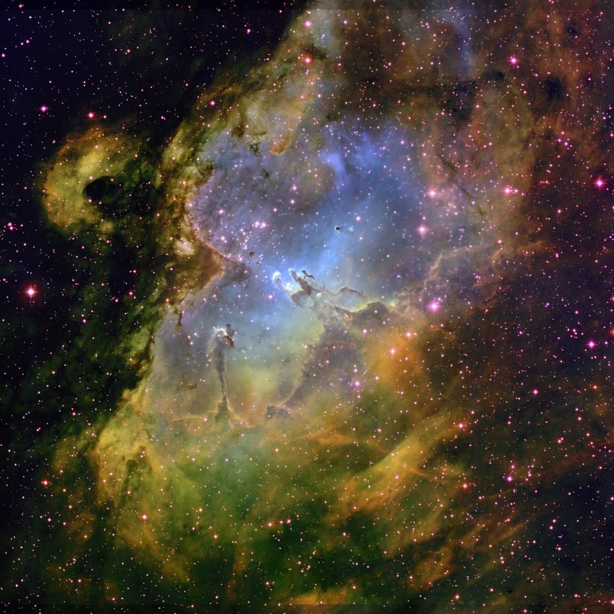

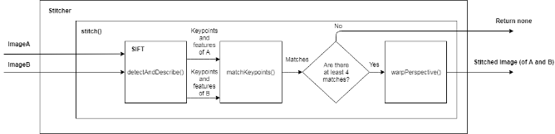


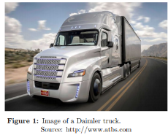
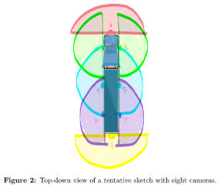
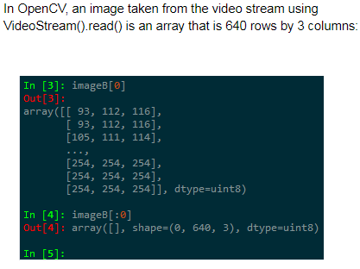
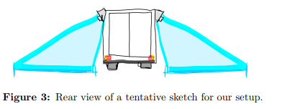
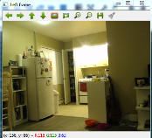
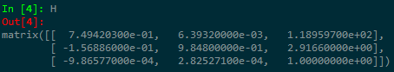
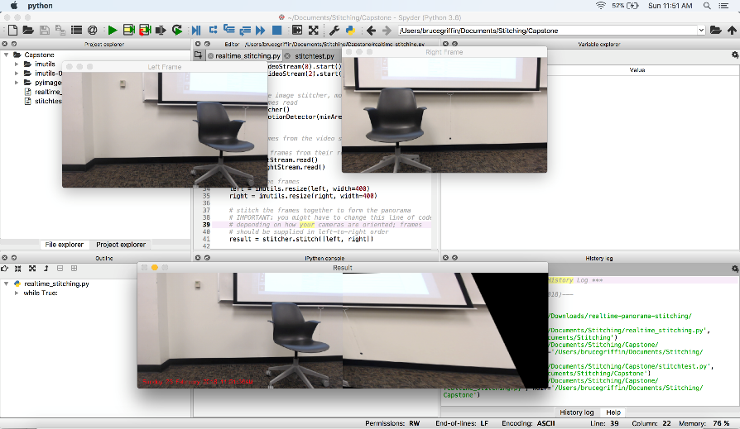
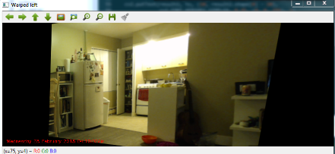
360 Degree Stitched
View for Daimler Trucks NA
Department of Electrical and
Computer Engineering (ECE)
Bruce Griffin, James Witcher, Jeff Udall, Matt Fleetwood
Professor Dan Hammerstrom
Portland State University, Portland, Oregon 97201-5256
Abstract
Real-time Stitching in OpenCV
Alternative Stitching Method
The goal of this project is to develop a proof-of-concept for a system and
methods which provide a 360 degree birds-eye view around a Daimler truck.
This will deliver a real-time video to the driver and account for the kink
angle between tractor and trailer during turns. Multiple cameras will be used
around the truck and the video streams will be stitched together to create
a single dynamic birds-eye view. While turning, the system will calculate
the kink angle and update the combined video view to compensate for the
shift in camera position during a turn. The driver will be able to use the
displayed birds-eye view video to conveniently inspect their surroundings and
avoid many blind-spots while operating the truck in real time.
Problem Conception
Advantages and Disadvantages
Homography Theory
Conclusion
Our team’s objective is to establish a proof-of-concept for a camera system that provides a 360 view to the driver on a display, accounting for the kink angle. We plan to investigate the use of at least 4 cameras, with a tentative upper-bound on the number of cameras used being approximately 8 or more. The cameras will be positioned around the truck as shown below in Figure 2.
Bibliography
[1] T. Ehlgen and T. Pajdla, Monitoring surrounding areas of truck-trailer
combinations, 5th International Conference on Computer Vision Systems,
2007.
[2] A. Rosebrock, "OpenCV panorama stitching," pyimagesearch, 2016.

Slide 20
Next Steps
Refine “stitching” goal with Daimler.
Check if Stitcher or “Splicer” methods are desirable
2. Continue testing both methods to compare / contrast their strengths/weaknesses.
Integrate all cameras for both methods.
Test on a mobile surface (e.g. Vikingbot, scaled truck model, rented trailer).

Slide 21
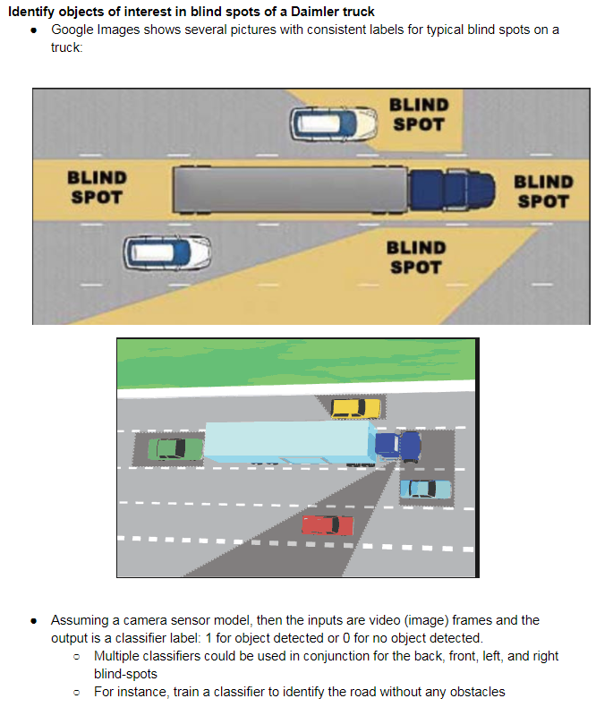
“Optional
extra” for
Concept 2

Slide 22
